Slide 1

Holistic Faculty Development:
Philosophy and Preparation
Jodi O’Brien, Jenny Loertscher & Colette Taylor
May 2023
Co-Sponsored by SU ADVANCE and the Center for Faculty Development

Slide 2

Overview:
I – Philosophy
II – Elements of a HFDP
III – Reflection & Writing Exercises

Slide 3
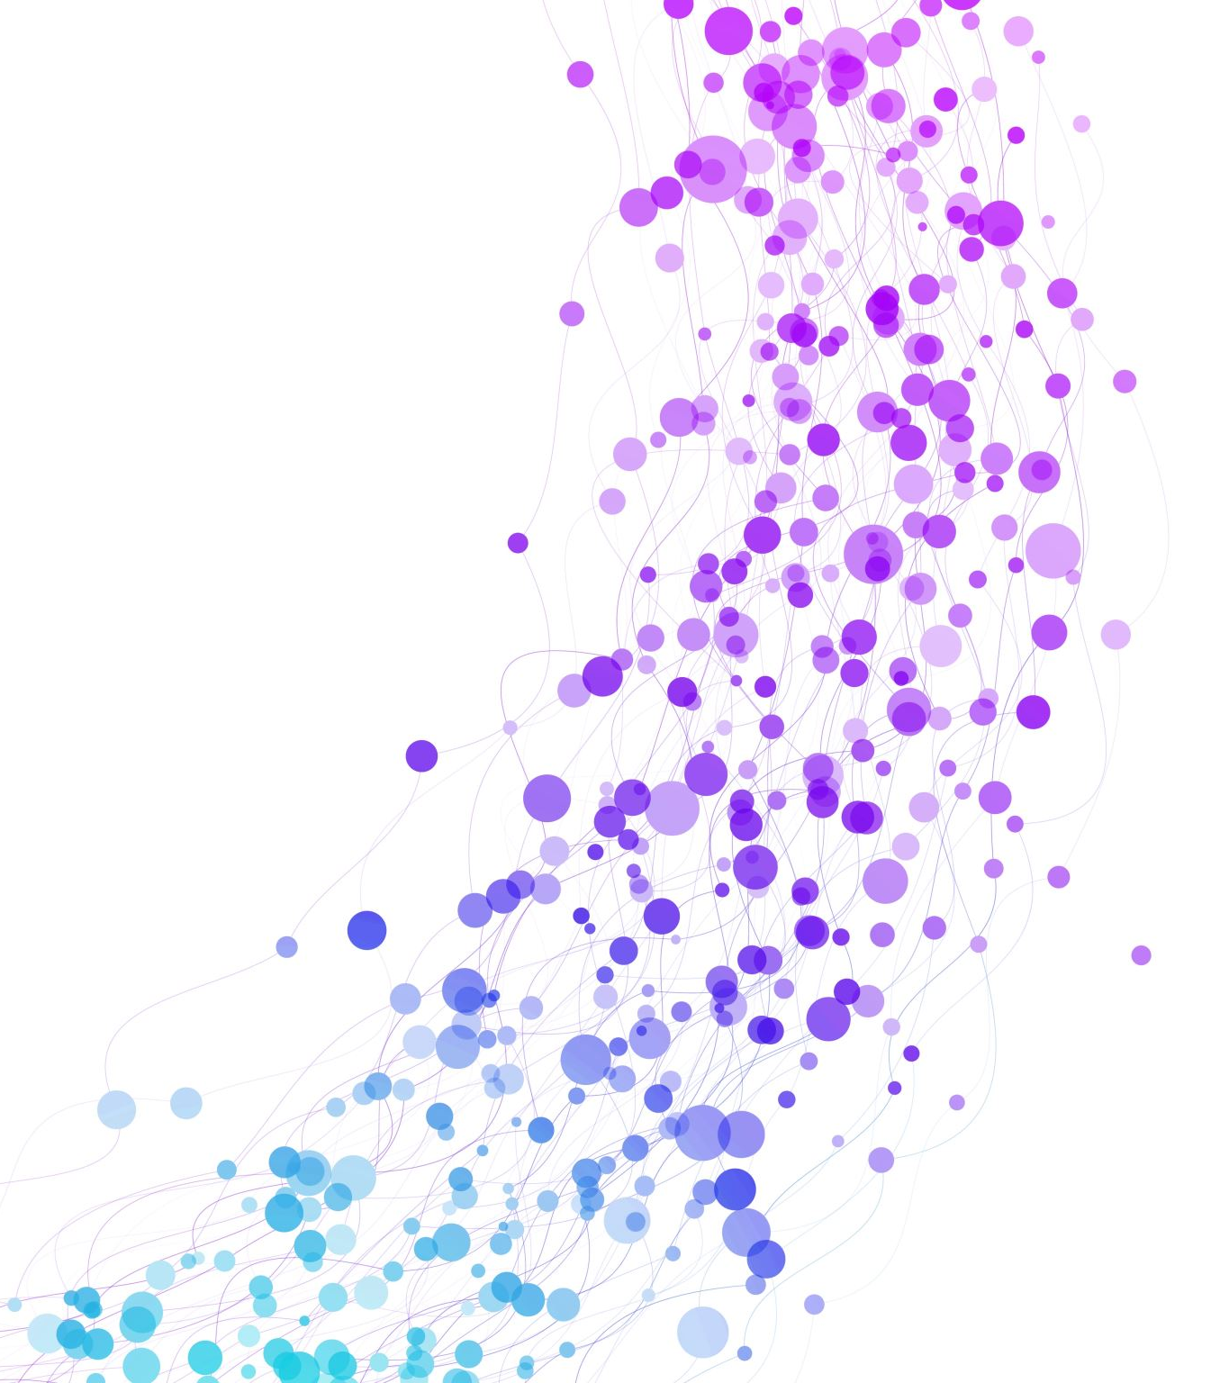
I-Philosophy
Recognize and reward an inclusive, comprehensive range of faculty activities that constitute the basis of higher education:
Student success
University community and governance
University reputation and rankings
Public engagement (democracy)

Slide 4
Revisioning the Professoriate
Critically examine taken-for-granted ideals regarding faculty careers and what counts
Broaden and complicate a culture of discipline-focused, “discovery” research memorialized through individual (competitive) faculty products
Develop practices, policies, and capacities for encouraging and evaluating comprehensive faculty careers

Slide 5

Faculty Promotion Standards are Incentive Structures
-Guide career planning
-Focus energy and commitment
-Often result in tension between institution-focused activities and traditional career expectations

Slide 6

What is Holistic Faculty Development?
INTENT
Post-tenure systematic focus and planning for integrated professional development and intentional contribution in specified domains.
Encourage formative conversations between faculty, deans (and where relevant, other faculty development personnel, e.g., chairs, associate deans).
Establish a specified reference basis for annual performance evaluations.

Slide 7

A Holistic Faculty Development Plan:
Is initiated in the first year post-tenure (where applicable, it can be included in sabbatical planning).
Is intended to be a dynamic, work-in-progress (propose, practice, reflection, revise).
Includes consideration and systematic development around:
  Faculty passions/expertise.
  Identified communities of practice.
  Alignment with SU mission.
  Alignment with SU professional responsibilities and opportunities.

Slide 8

Professional Identity
I am a ___________?
In a few words or a phrase, how would you describe your professional identity?
(be creative, have fun with this)

Slide 9
Reflection:
  What is the impact you intended to make when you entered the profession?
  What have you learned from going through the tenure process about yourself?
  What are you passionate about in context of your professional identity?
  How would you describe your specific forms of expertise?
  How does this expertise show up in your professional life?
  How does this expertise show up in your university engagements?
  What are the unifying themes of your professional life?
  How does your professional identity and journey to professor align with Seattle University’s mission?

Slide 10

Identifying “Communities of Practice”:
Who/what are the professional audiences in your head?
Where/how do you aspire to have impact? How would you demonstrate that impact?
What contributions are you already making that you think don’t count; how might you develop these?

Slide 11

Narrating Your Professional Journey:
Elements of Holistic Development
Personalized/Reflective
Thematic (what’s the arc of your story?)
Integrated (holistic)
Indicative of growth/trajectory
Mission-Aligned
Clear description of communities of practice (discipline ,university, specific publics, communities, etc.)
Specifics: activities & evidence of impact/contribution

Slide 12

Do I Have to Do Everything?
Teaching excellence as baseline + evidence of programmatic development and contribution in one or more areas related to general mission
Case 1: Teaching + Scholarly record of accomplishment evidenced by discipline-based products + demonstration of institutional service/citizenship
Case 2: Teaching + Significant institution building grounded in scholarly expertise + evidence of ongoing scholarly engagement (not discipline-based products)
Case 3: Teaching + Evidence of high impact community engagement/public engagement + integration in related SU activities and reputation

