Slide 1
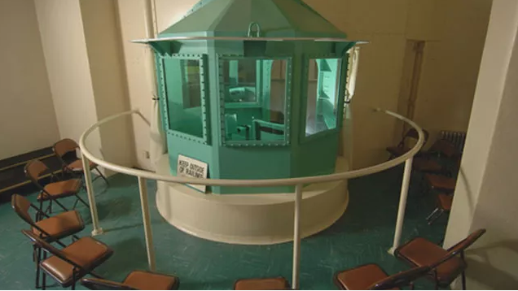
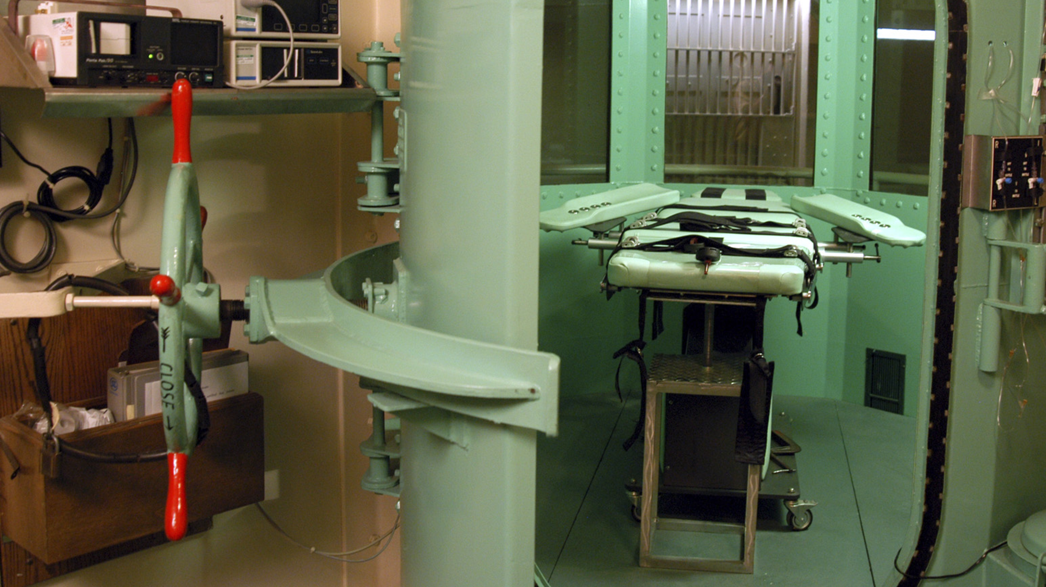
Defending Capital Cases

Slide 2
“Death is Different”
The trials are different: Two phases, guilt and penalty
The juries are different: “Death qualified”
The accused and the crimes are different: “Worst of the worst”
The lawyers are different: At least they should be…

